Slide 1

.NET Bootcamp

Slide 2
Overview
Client/Server Communication
Understanding URLs
HTTP Request/Response
Review UI mockups
GitHub Setup
For next class

Slide 3
Client/Server Communication
Clients request a resource
Server responds to that request with that resource or an error status
In the context of web applications:
Client requests a web page via URL
Server processes that request and returns the web page or an error page

Slide 4
Client/Server Communication
Networked Applications
Client and server are separate programs
Can run and connect on same machine or run and connect from different machines across the network
In both cases, they use the same network protocols

Slide 5
Client/Server Communication
Clients
Web Browsers
Desktop: Chrome, Firefox, Edge, IE, Safari, etc.
Mobile: Chrome, Safari, etc.
Other Programs
Instead of a user at a browser making a request, it could be another program (apps, scripts, etc.)
Google does this to crawl the internet
Our own applications can do it as well using APIs

Slide 6
Understanding URLs
What is a URL?
Uniform Resource Locator aka web address
https://www.dotnetbootcamp.com/index.html

Slide 7
Understanding URLs
Parts of the URL
https://www.dotnetbootcamp.com/index.html 1 2 3
1. Application Protocol
2. Hostname
3. Resource Path

Slide 8
Understanding URLs
Application Protocols
HTTP – HyperText Transfer Protocol
HTTPS – Secure HyperText Transfer Protocol (using SSL encryption)
2. Hostname
Registered Name
TLD – Top-Level Domain (.com, .net, .edu, etc.)
3. Resource Path
Maps to a filesystem path for a specific document
Or, the path is passed to a web app as input

Slide 9
Hostname
How does the hostname get us to a specific server computer?
Computers on a network are assigned an IP (Internet Protocol) address for computer to computer communication
For computers on the internet, your Internet Service Provider (ISP) assigns you the address
These are known as public IP addresses
An IPv4 address is a 32-bit number with each byte separated by a . (dot)
162.243.166.170

Slide 10
Private IP Addresses
Private IP addresses can be used in closed networks (virtual networking, soho, WiFi APs)
127.0.0.1 and localhost refer to the local machine
0.0.0.0 refers to the default address for the local machine
10.0.0.0 – 10.255.255.255
172.16.0.0 – 172.31.255.255
192.168.0.0 – 192.168.255.255

Slide 11
How Domain Names are Translated
How is dotnetbootcamp.com translated to 162.243.166.170?
Domain Name System
A decentralized hierarchy of servers provide domain name resolution
Service maps registered hostnames (domain names) to IP addresses
https://howdns.works/

Slide 12
General URL Format
scheme:[//[user:pass@]host[:port]][/]path[?query][#fragment]
scheme: Application protocols (http/https)
[user:pass@]: Optional. Used for Authentication information
host: A hostname or IP address
[:port]: Optional. HTTP defaults to 80, HTTPS defaults to 443
path: Resource location. Can be /
[?query]: Optional. Parameter and Argument list passed to web app
[#fragment]: Optional. Identifier for secondary resource. Evaluated by client

Slide 13
Retrieving Webpages From a Server
How does the client (web browser) retrieve webpages from a server using URLs?
http://dotnetbootcamp.com/index.html
Extract domain name from URL
Lookup IP for domain name via DNS
Send the entire URL request to the IP found in step (2)
Receive the documents requested via path

Slide 14
Additional Resources
https://en.wikipedia.org/wiki/URL
https://en.wikipedia.org/wiki/List_of_Internet_top-level_domains

Slide 15
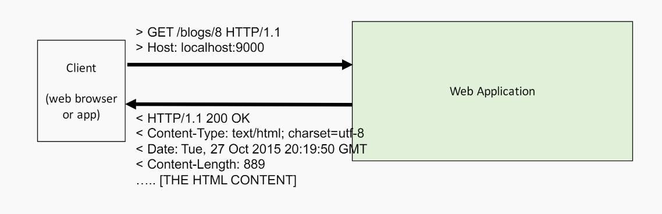
HTTP Request/Response
What is happening when we call an HTTP URL?
We send a HTTP Request
We receive a HTTP Response
The payload may include HTML, JSON, or nothing

Slide 16
HTTP Request/Response
HTTP is Stateless
Does not require the server to retain information or status about user for the duration of multiple requests
Some web applications implement states or server-side sessions using cookies or hidden variables within web forms
The browser opens a connection upon request and is closed once the response is received

Slide 17
The Request – HTTP Verbs
When we load a URL in our browser, we are making a GET request
These requests are called HTTP Verbs
They do not explicitly change anything about the request except some headers that are being sent. It is up to the web application to interpret them appropriately.
https://en.wikipedia.org/wiki/Hypertext_Transfer_Protocol#Request_methods

Slide 18
HTTP Verbs
GET
Typically use this request to retrieve a resource
Should not modify the content
POST
Use this request to create a new resource entity
PUT
Use this request to update an existing resource entity
DELETE
Use this request to delete an existing resource entity

Slide 19
The Response
HTTP returns a status code in the header
The status code lets the client know if the request succeeded, failed, or some other action is required
In additional to status code, content may be included in the response (HTML, JSON, XML, etc.)

Slide 20
The Response – Status Codes
200 – Success
201 – Created
301 – Moved permanently
303 – See other (redirect)
400 – Bad request
404 – Not found
5xx – Server errors
https://en.wikipedia.org/wiki/List_of_HTTP_status_codes

Slide 21
Review UI Mockups

Slide 22
GitHub Setup

Slide 23
For Next Class
Continue to break down your application into manageable tasks and create issues in GitHub

